Slide 1

How to Make ChatGPT, Google AI, and Perplexity Recommend Our Moving Companies
DOMINATING AI SEARCH
A LEAD GENERATION STRATEGY FOR GLOBAL SALES FORCE
Prepared by Justin / HaVoK March 2026

Slide 2

THE SEARCH LANDSCAPE
Traditional Search Is Declining — AI Search Is Taking Over
The way consumers find movers is shifting dramatically. Instead of scrolling through Google's 10 blue links, people are now asking AI chatbots directly: "What are the best long-distance movers?"
-25%
2B+
Projected drop in traditional search volume in 2026 (Gartner)
Monthly users reached by Google AI Overviews
The question is no longer "Are we on page 1 of Google?" — it's "Does ChatGPT recommend us?"
800M
100M+
Users served by ChatGPT every single week
Queries processed by Perplexity monthly

Slide 3

STRATEGIC VALIDATION
Social Media and Reddit Directly Influence What AI Recommends
Alex's core idea — using community platforms to shape AI recommendations — is backed by data: Reddit is a notable source LLMs draw from when answering queries.
Reddit captures 2–3% of ChatGPT citations (Profound/Semrush research)
99% of Reddit citations come from individual discussion threads, not main pages
01
02
Low-engagement posts get cited: AI-cited posts had far fewer comments and upvotes than viral posts
AI engines favor earned media (community discussions, third-party reviews) over brand-owned content
Building presence on social platforms to influence AI is the right strategy. Execution and consistency determine impact.
03
04

Slide 4
CRITICAL WARNING
The FTC Now Penalizes Fake Posts Up to $53,088 Per Violation
While the goal is correct, posting manufactured questions and answers on Reddit (known as "astroturfing") is now explicitly illegal under federal law.
!
FTC Consumer Reviews Rule: Effective Oct 21, 2024, prohibits businesses from creating or disseminating fake reviews or testimonials.
!
Massive Financial Penalties: Civil penalties reach $53,088 per violation as of 2025.
CATASTROPHIC RISK: With 14 brands under one umbrella, getting caught would be devastating — one scandal could damage all companies simultaneously.
!
Active Enforcement: The FTC sent warning letters to 10 companies in December 2025 as its first enforcement action.
!
Reddit Backlash: Reddit actively detects and bans astroturfing; 63.2% of Reddit threads ranking for branded searches are negative toward the brand.

Slide 5
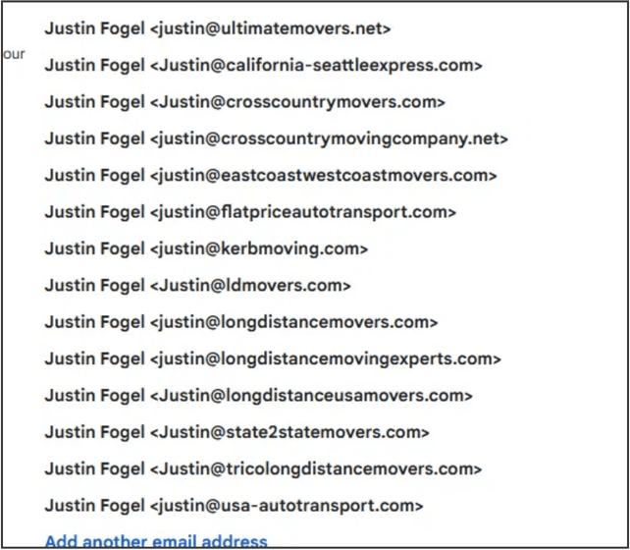
STRATEGIC ASSET
Our 14 Brands Are a Massive Competitive Advantage
14 keyword-rich domains are a major asset for AI search — exact-match domains are what AI recommends.
7 Long-Distance / Cross-Country Moving brands
2 Auto Transport brands
2 General Moving brands
2 Regional / Route-Specific brands
1 Interstate Moving brand
Most competitors have one brand. We have 14 — allowing multiple AI recommendation slots.
Global Sales Force Domain Portfolio

Slide 6

THE NEW PARADIGM
GEO Is the Legitimate, Scalable Way to Win AI Recommendations
Generative Engine Optimization (GEO) is the practice of structuring a brand's digital presence so that AI-powered search platforms can retrieve, cite, and recommend it. Think of it as SEO for the AI era.
TRADITIONAL SEO
GEO STRATEGY
Ranking on Google's page 1 among 10 blue links
Being one of 2-7 brands an AI engine names in its answer
THE SHIFT IN TACTICS
SEO RELIES ON
GEO RELIES ON
GEO is now a recognized discipline with dedicated conferences, agency specializations, and purpose-built tools. This is not experimental — it's mainstream.
Keyword density, backlinks, and technical site structure
Entity authority, earned media, structured data, and freshness

Slide 7
PHASE 1 — TECHNICAL FOUNDATION
Make All 14 Websites AI-Ready with Technical Optimization
The first step is ensuring AI engines can properly read and understand our websites. Most businesses skip this step entirely, giving us an immediate advantage.
01
Schema Markup Implementation
02
Comprehensive FAQ Development
Add structured data (Organization, LocalBusiness, FAQ, Review) to all 14 sites so AI engines can parse our content and services.
Build detailed FAQ pages on every site answering key customer questions — AI engines rely heavily on Q&A pairs.
TIMELINE
4 Weeks
INVESTMENT
Low
03
AI Crawler Access
High — Foundation for everything
Audit robots.txt files across all domains to ensure GPTBot, ClaudeBot, and PerplexityBot are not blocked; add llms.txt files to guide AI interpretation.
IMPACT

Slide 8
PHASE 2 — ENTITY AUTHORITY (MONTHS 1-3)
Strengthen Brand Signals So AI Engines Recommend Us with Confidence
AI engines cross-reference multiple signals before recommending a business. The stronger and more consistent our brand presence is across the web, the more likely AI will cite us.
01
Directory Consistency
Ensure Name, Address, and Phone (NAP) data is consistent across Google Business Profile, Yelp, BBB, Trustpilot, and industry directories for all 14 brands.
02
Genuine Review Generation
Systematically request reviews from satisfied customers; genuine positive reviews across multiple platforms are a primary AI recommendation signal.
TIMELINE
Months 1-3
INVESTMENT
Medium
IMPACT
Very High
03
Digital PR Campaign
Earned media is the #1 factor AI engines use for recommendations.
Pursue earned media by pitching moving tips and industry insights to local news, industry publications, and "best movers" roundup articles.

Slide 9
PHASE 3 — AUTHENTIC COMMUNITY ENGAGEMENT
Win Reddit the Right Way — With Genuine Expertise, Not Fake Posts
Instead of manufacturing fake Reddit discussions, we deploy knowledgeable team members to participate authentically in moving-related communities. This builds the exact kind of organic presence that AI engines trust and cite.
>
Participate in relevant subreddits: r/moving, r/MovingDay, r/personalfinance, r/Frugal, and city-specific subreddits.
>
Answer real questions with genuinely helpful moving advice (packing tips, cost estimates, timing recommendations).
>
No overt brand promotion — just authentic expertise that builds trust and entity authority over time.
WHY THIS WORKS
AI engines specifically look for authentic community discussions. A genuine, helpful answer from a real expert carries far more weight than a manufactured post — and it's completely legal and risk-free.
>
Share industry knowledge when appropriate that naturally positions our team as moving experts.

Slide 10
PHASE 4 — CONTENT LEADERSHIP (MONTHS 3-12)
Publish Original Data and Research That AI Engines Must Cite
The ultimate GEO strategy is creating content that no one else has. When we publish proprietary data and original research, AI engines have a unique reason to cite us over every competitor.
01
Original Research Reports
Publish data like "Average Moving Costs by State in 2026" or "The State of Long-Distance Moving in America" using our operational data across 14 brands.
THE MULTI-BRAND ADVANTAGE
02
Multi-Brand Differentiation
When ChatGPT lists the "best long-distance movers," we don't just want one slot — we want three or four. With 14 differentiated brands, this is entirely achievable through legitimate means.
Position each brand with a distinct identity (budget-friendly, premium service, fastest delivery, best auto transport) so the conglomerate captures multiple AI recommendation slots simultaneously.

Slide 11
IMPLEMENTATION TIMELINE
A 12-Month Roadmap to AI Search Dominance
PHASE
TIMELINE
FOCUS AREA
EXPECTED IMPACT
Phase 1: Technical Foundation
AI engines can read and index all 14 sites
Weeks 1-4
Schema markup, FAQs, AI crawlability
Phase 2: Entity Authority
Brands begin appearing in AI recommendations
Months 1-3
Reviews, directories, digital PR
Phase 3: Community Engagement
Ongoing
Authentic Reddit and social participation
Organic mentions fuel AI citations
Phase 4: Content Leadership
Original research, brand differentiation
Multiple brands dominate AI recommendation lists
Months 3-12
KEY METRIC TO TRACK
AI Citation Frequency — how often our brands appear in AI-generated answers vs. competitors.

Slide 12
THE BOTTOM LINE
Your Vision + The Right Execution = Market Dominance
Alex, pursuing AI search optimization is the right move — our 14 keyword-rich domains give us an unmatched lead-generation edge.
■
AI search is replacing traditional search — be where customers go.
■
Reddit influences AI — strategy validated.
■
Legitimate GEO outperforms astroturfing — more durable.
NEXT STEP
Start Phase 1 this week; Justin's team will begin the technical foundation across all domains.
■
With 14 brands — dominate recommendation slots.
■
FTC enforcement is active — we protect the portfolio.

